Slide 1


COVID-19 DETECTION FROM LUNGS X-RAY USING DEEP LEARNING
Submitted by
NITHIN PRITHIV J 512220104023
ROGITH A 512220104027
……………………..................................................................
GUIDE
DR.V.RAJI Asso.Prof/CSE
Department of Computer Science

Slide 2
AGENDA:
Introduction
Abstract
Existing System
Dis-advantage
Proposed System
Advantage
Software and hardware
System Architecture
Output

Slide 3


Slide 4
Introduction
Abstract
Existing System
Proposed System
Software and hardware
System Architecture
ER-Diagram

Slide 5
Introduction
COVID-19 is a highly infectious respiratory disease caused by the SARS-CoV-2 virus that has spread globally and has resulted in a significant impact on public health and the economy.
Lung X-rays are one of the most common imaging methods used for diagnosing COVID-19, and they can provide valuable information about the severity and progression of the disease.
Deep learning, a branch of machine learning, has shown promising results in detecting COVID-19 from lungs X-rays by analyzing patterns and features in the images.
Abstract
Existing System
Proposed System
Software and hardware

Slide 6
Introduction
COVID-19 is a highly infectious respiratory disease caused by the SARS-CoV-2 virus that has spread globally and has resulted in a significant impact on public health and the economy.
Lung X-rays are one of the most common imaging methods used for diagnosing COVID-19, and they can provide valuable information about the severity and progression of the disease.
Deep learning, a branch of machine learning, has shown promising results in detecting COVID-19 from lungs X-rays by analyzing patterns and features in the images.
Abstract

Slide 7
Introduction
Abstract
Problem: Detecting COVID-19 from lung X-rays is crucial in disease diagnosis.
Approach: Using deep learning models to extract features indicative of COVID-19 infection.
Dataset: A diverse and representative dataset of lung X-rays including COVID-19 positive and negative cases.
Results: High accuracy in COVID-19 detection using deep learning models.
Implications: Potential for real-time detection and integration with healthcare systems for clinical decision-making.
Existing System
Proposed System
Software and hardware

Slide 8
Introduction
Abstract
Problem: Detecting COVID-19 from lung X-rays is crucial in disease diagnosis.
Approach: Using deep learning models to extract features indicative of COVID-19 infection.
Dataset: A diverse and representative dataset of lung X-rays including COVID-19 positive and negative cases.
Results: High accuracy in COVID-19 detection using deep learning models.
Implications: Potential for real-time detection and integration with healthcare systems for clinical decision-making.
Existing System
Details are stored in paper.
Maintenance is a huge problem.
Updation is a tedious task.
Performance is not achieved up to the requirements.
Authorised person maintains the transportation details in papers

Slide 9
Introduction
Abstract
Existing System
Uses Convolutional Neural Networks (CNNs) to extract features from X-ray images.
Trained on a large dataset of COVID-19 positive and negative cases.
Achieves high accuracy, sensitivity, and specificity in COVID-19 detection.
Can be deployed in a production environment for real-time detection.
Offers potential to assist radiologists and healthcare professionals in diagnosing COVID-19.
Dis-advantages
Proposed System
Software and hardware
System Architecture
ER-Diagram

Slide 10
Introduction
Abstract
Existing System
Uses Convolutional Neural Networks (CNNs) to extract features from X-ray images.
Trained on a large dataset of COVID-19 positive and negative cases.
Achieves high accuracy, sensitivity, and specificity in COVID-19 detection.
Can be deployed in a production environment for real-time detection.
Offers potential to assist radiologists and healthcare professionals in diagnosing COVID-19.
Proposed System
Software and hardware
System Architecture
ER-Diagram

Slide 11
Introduction
Abstract
Existing System
Dis-advantages
Dependence on quality of X-ray imaging.
May require a large dataset for training, which can be difficult to obtain.
May have limited performance in detecting early stages of the disease.
Possible biases in the dataset can affect the accuracy of the model.
May not be a substitute for a clinical diagnosis by a medical professional.
Proposed System
Software and hardware
System Architecture
ER-Diagram

Slide 12
Introduction
Abstract
Dis-advantages
Dependence on quality of X-ray imaging.
May require a large dataset for training, which can be difficult to obtain.
May have limited performance in detecting early stages of the disease.
Possible biases in the dataset can affect the accuracy of the model.
May not be a substitute for a clinical diagnosis by a medical professional.
Proposed System
Software and hardware
System Architecture
ER-Diagram

Slide 13
Introduction
Abstract
Existing System
Proposed System
Collect diverse dataset of lungs X-rays with COVID-19 positive and negative cases
Preprocess data by cleaning, resizing, and normalization
Train deep learning model on preprocessed dataset and tune hyperparameters
Test model on separate dataset and evaluate performance metrics
Deploy model in production environment and integrate with other healthcare systems for seamless information exchange.
Advantages
Software and hardware
System Architecture
ER-Diagram

Slide 14
Introduction
Abstract
Proposed System
High accuracy and sensitivity in detecting COVID-19 compared to traditional diagnostic methods
Fast and efficient screening process that can aid in early detection and treatment
Non-invasive and safe method that reduces patient discomfort and exposure to radiation
Can be easily integrated with existing healthcare systems to facilitate clinical decision-making
Can help alleviate the burden on healthcare providers and resources during the pandemic.
Proposed System
Software and hardware
System Architecture
ER-Diagram

Slide 15
Introduction
Abstract
Existing System
Proposed System
Advantages
High accuracy and sensitivity in detecting COVID-19 compared to traditional diagnostic methods
Fast and efficient screening process that can aid in early detection and treatment
Non-invasive and safe method that reduces patient discomfort and exposure to radiation
Can be easily integrated with existing healthcare systems to facilitate clinical decision-making
Can help alleviate the burden on healthcare providers and resources during the pandemic.
Software and hardware
System Architecture
ER-Diagram

Slide 16
Introduction
Abstract
Advantages
High accuracy and sensitivity in detecting COVID-19 compared to traditional diagnostic methods
Fast and efficient screening process that can aid in early detection and treatment
Non-invasive and safe method that reduces patient discomfort and exposure to radiation
Can be easily integrated with existing healthcare systems to facilitate clinical decision-making
Can help alleviate the burden on healthcare providers and resources during the pandemic.
Proposed System
Software and hardware
System Architecture
ER-Diagram

Slide 17
Introduction
Abstract
Existing System
Proposed System
Software and hardware
Software Requirement:
Processor : Intel Core i3 or Higher/AMD Processors
RAM : 4GB or Higher(Recommended)
Hard Disk : 50GB or Higher(Recommended)
Operating System : Windows 7 or Higher
Coding Language : python 3.8.4
Database : MY_SQL
Software Using : python-kivy,cv2
BC DLL :PyChain
Editor :VS Code
Hardware Requirement:
System Architecture
ER-Diagram

Slide 18
Introduction
Abstract
Software Requirement:
Processor : Intel Core i3 or Higher/AMD Processors
RAM : 4GB or Higher(Recommended)
Hard Disk : 50GB or Higher(Recommended)
Hardware Requirement:
Operating System : Windows 7 or Higher
Coding Language : python 3.8.4
Database : MY_SQL
Software Using : python-kivy,cv2
BC DLL :PyChain
Editor :VS Code
Proposed System
Software and hardware
System Architecture
ER-Diagram

Slide 19
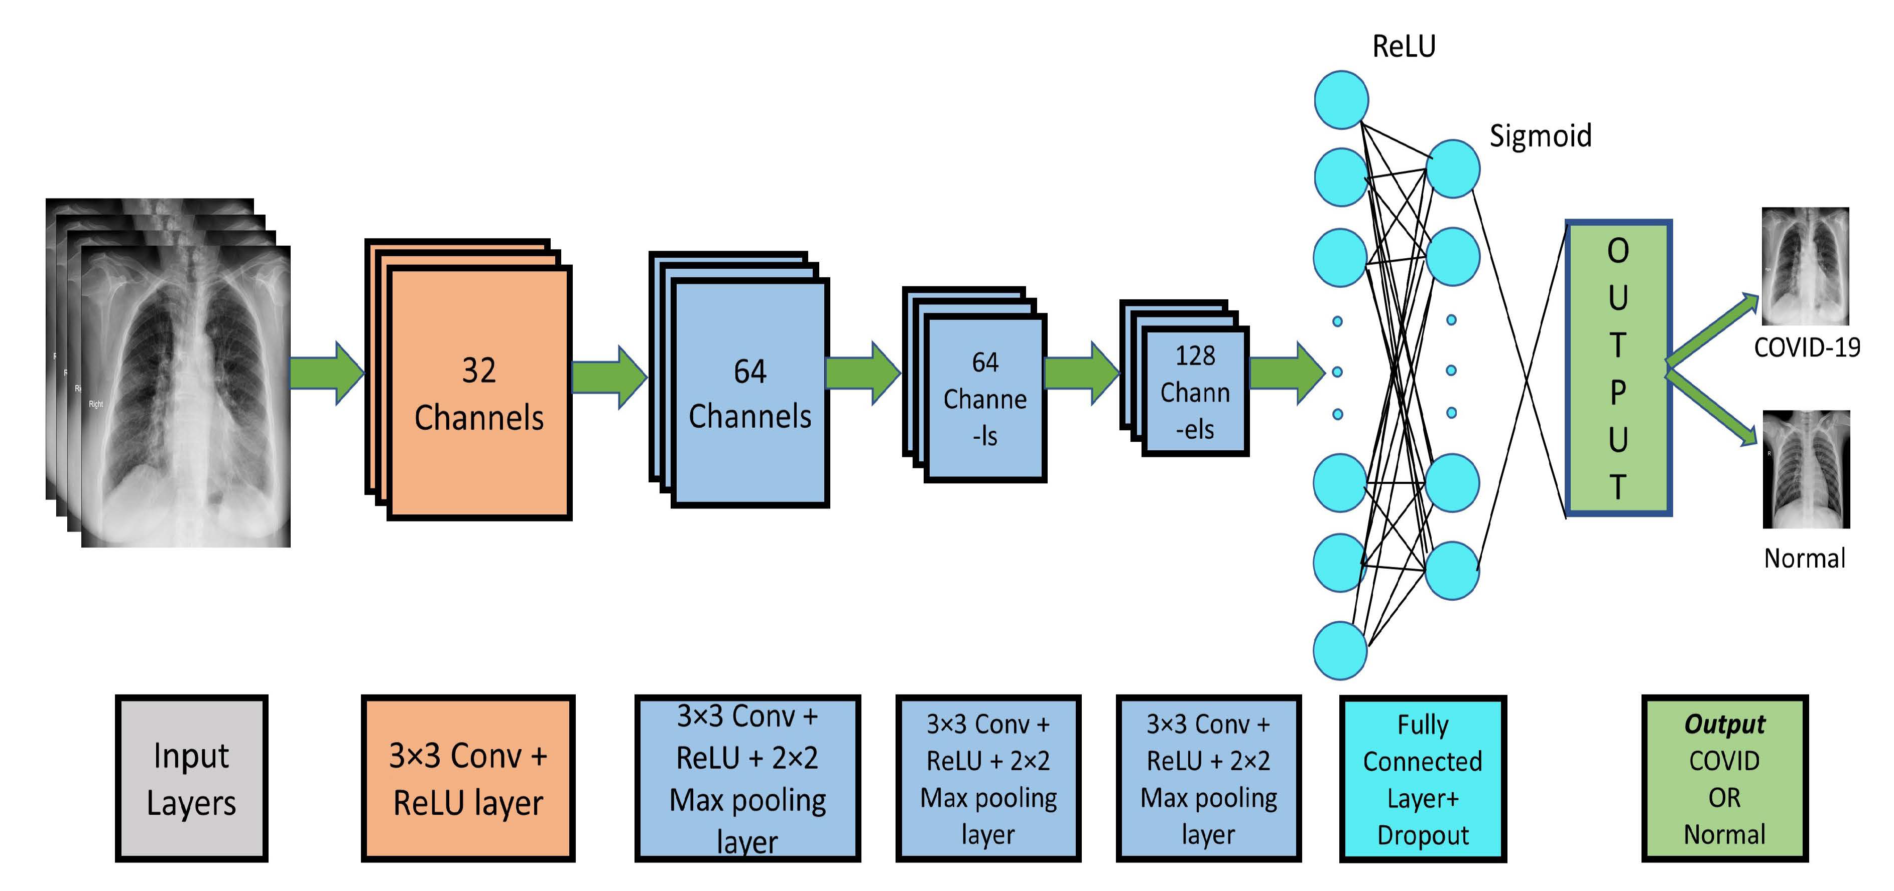
Introduction
Abstract
Existing System
Proposed System
Software and hardware
System Architecture
ER-Diagram

Slide 20
Introduction
Abstract
System Architecture
Proposed System
Software and hardware
System Architecture
ER-Diagram

Slide 21

Want big impact?
Use big image.

Slide 22
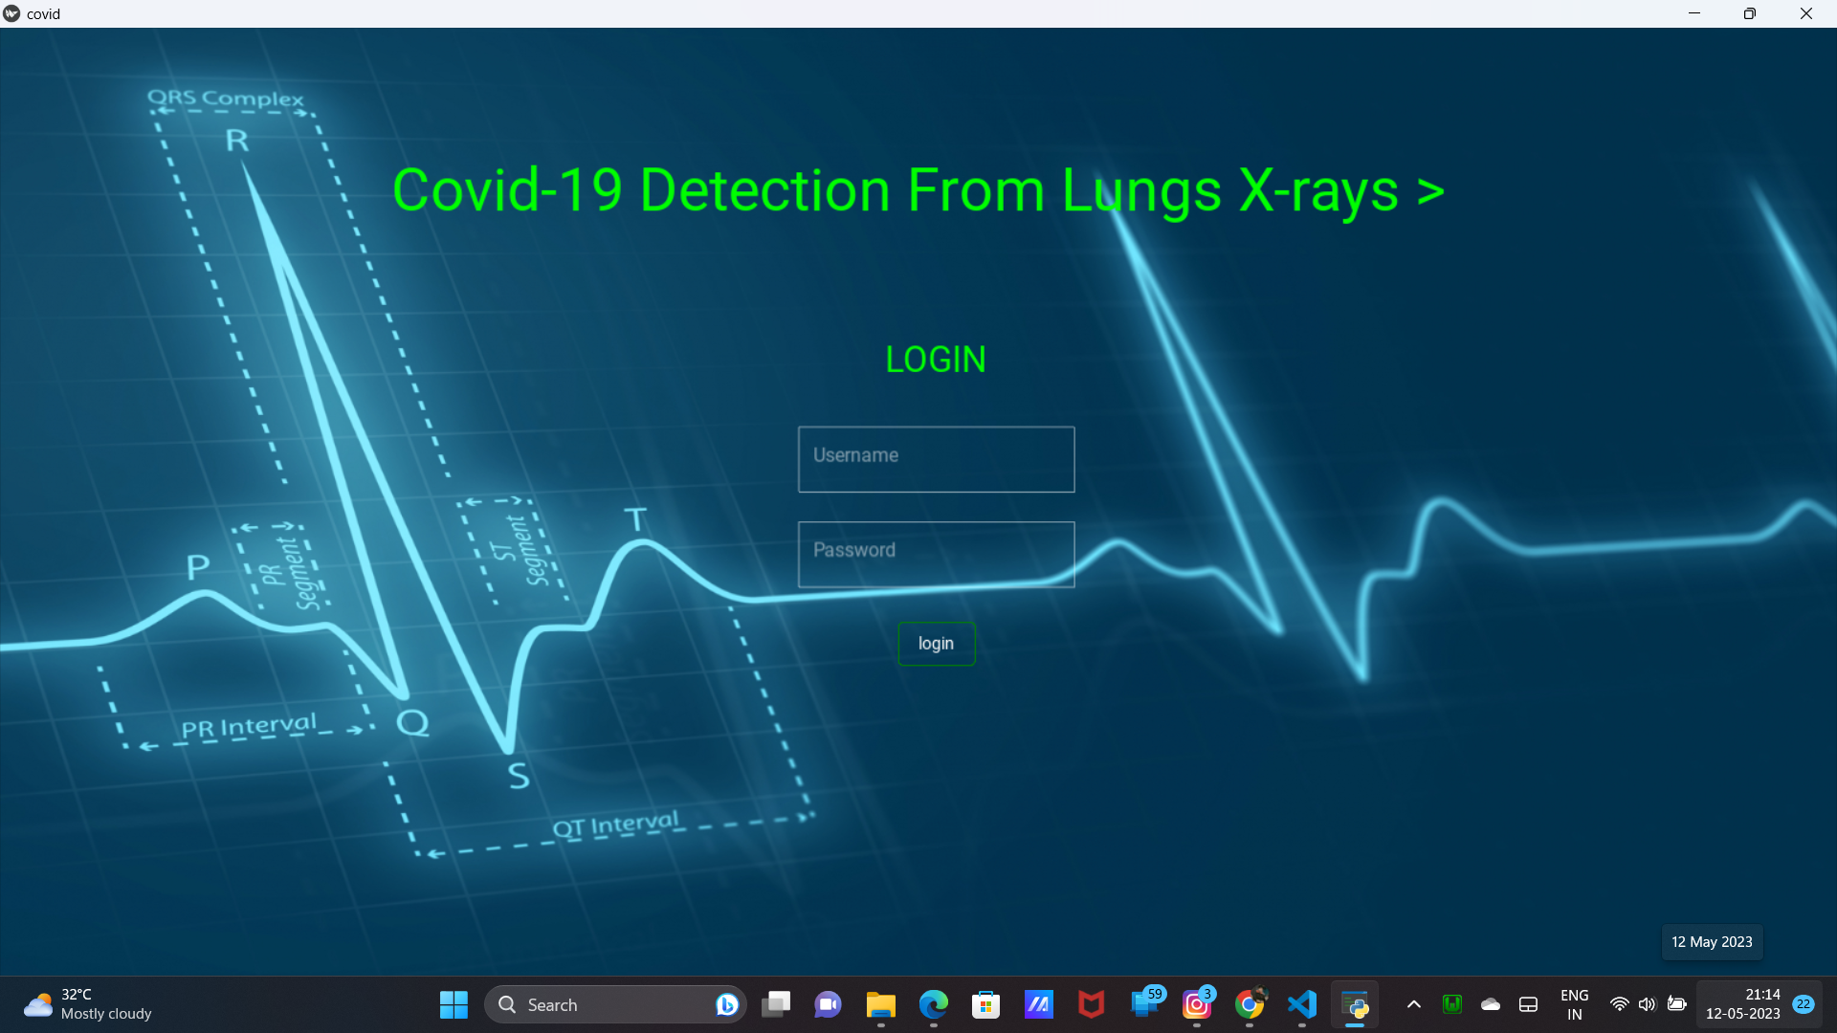
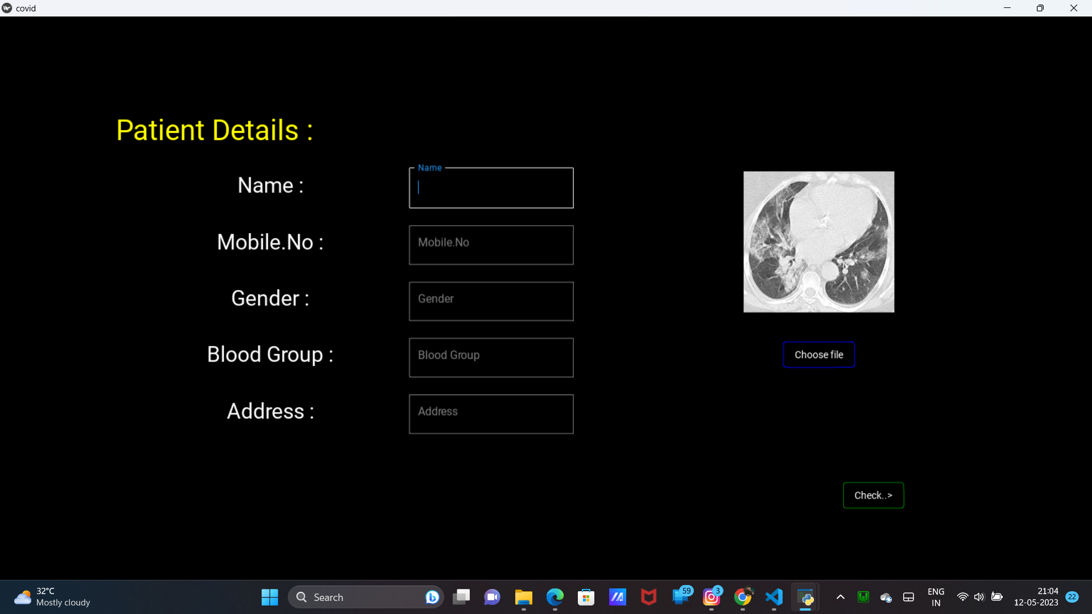
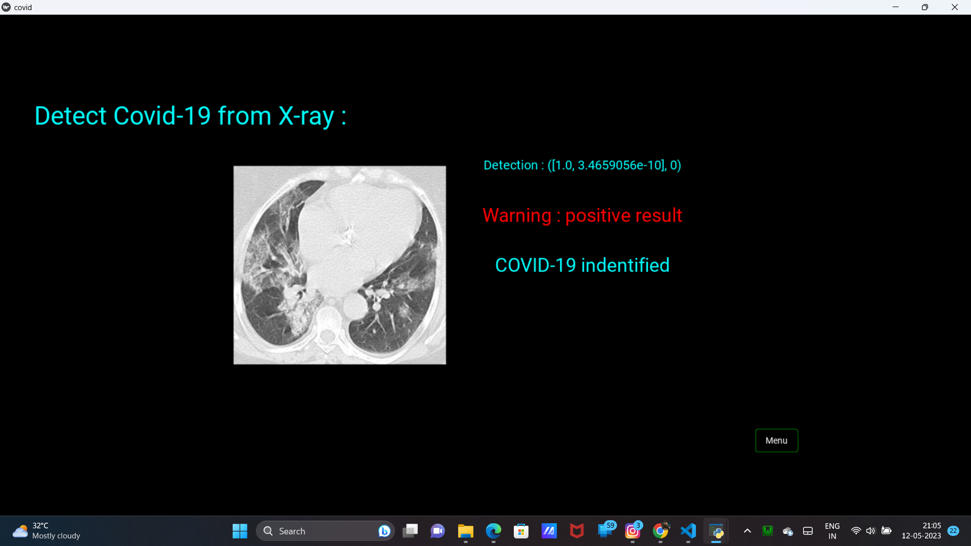
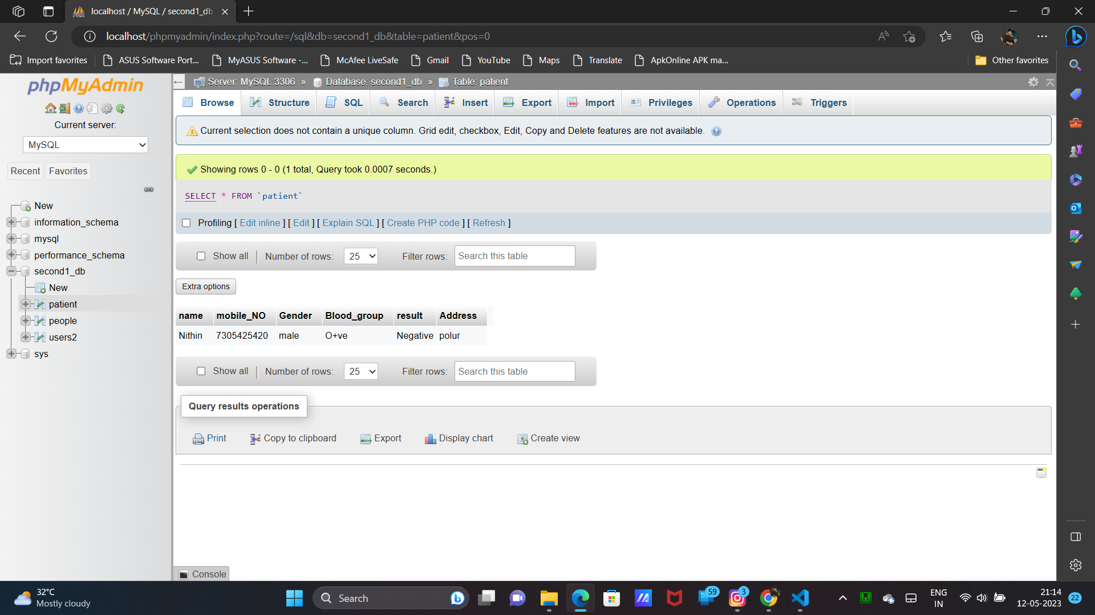

Slide 23
Introduction
Abstract
Login Page
Proposed System
Software and hardware
System Architecture
ER-Diagram

Slide 25
Introduction
Abstract
Details Page
Proposed System
Software and hardware
System Architecture
ER-Diagram

Slide 27
Introduction
Abstract
Result Page
Proposed System
Software and hardware
System Architecture
ER-Diagram

Slide 29
Introduction
Abstract
Database Page
Proposed System
Software and hardware
System Architecture
ER-Diagram

Slide 30


Thanks!
Any questions?

Slide 31
Thanks!
Any questions?

